Slide 1

AudioStation
A platform for musical collaboration

Slide 2
What’s the problem?
Throughout my entire experience of being a musician, I’ve wanted to jam with more people
Often lack the time or the right connections
I also want to write and record music with the musicians I do know
But lack the space/equipment to do so

Slide 3

But to make matters worse...

Slide 4

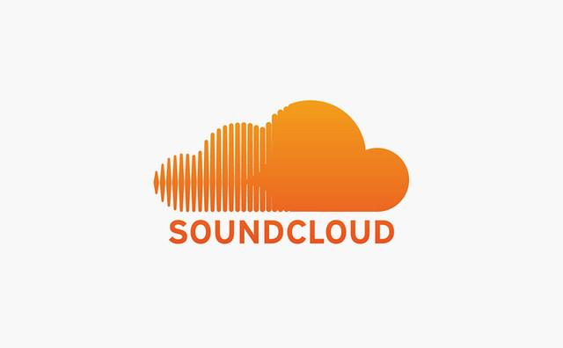
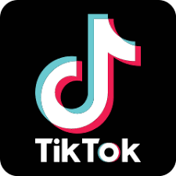
What did I do?
I decided to design a web application that would allow me to write and record music with not only my friends, but with RANDOM PEOPLE
Think SoundCloud mixed with the “react” feature on TikTok (if you’re into that kinda thing)
+
Follow me:
@seps.jams

Slide 5
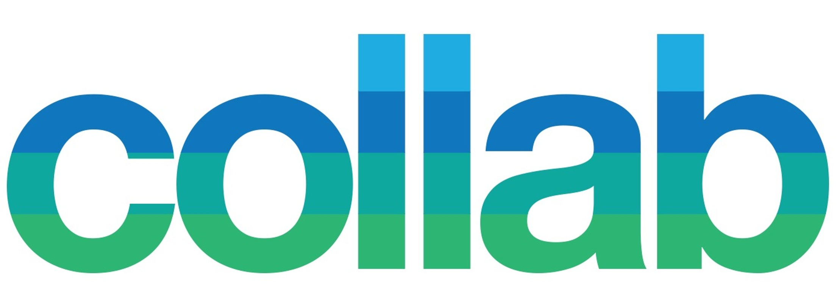
The basic idea
First a user uploads a demo of their project so far, along with all the associated files
This project will appear in a feed on the homepage of other users, where they will be able to listen, download, and collab
When a collab is uploaded, all users that have collaborated thus far are automatically tagged

Slide 6
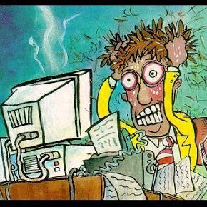
My Approach...
Django
Bootstrap
Tiny bit of jquery
Never done true web dev before

Slide 7
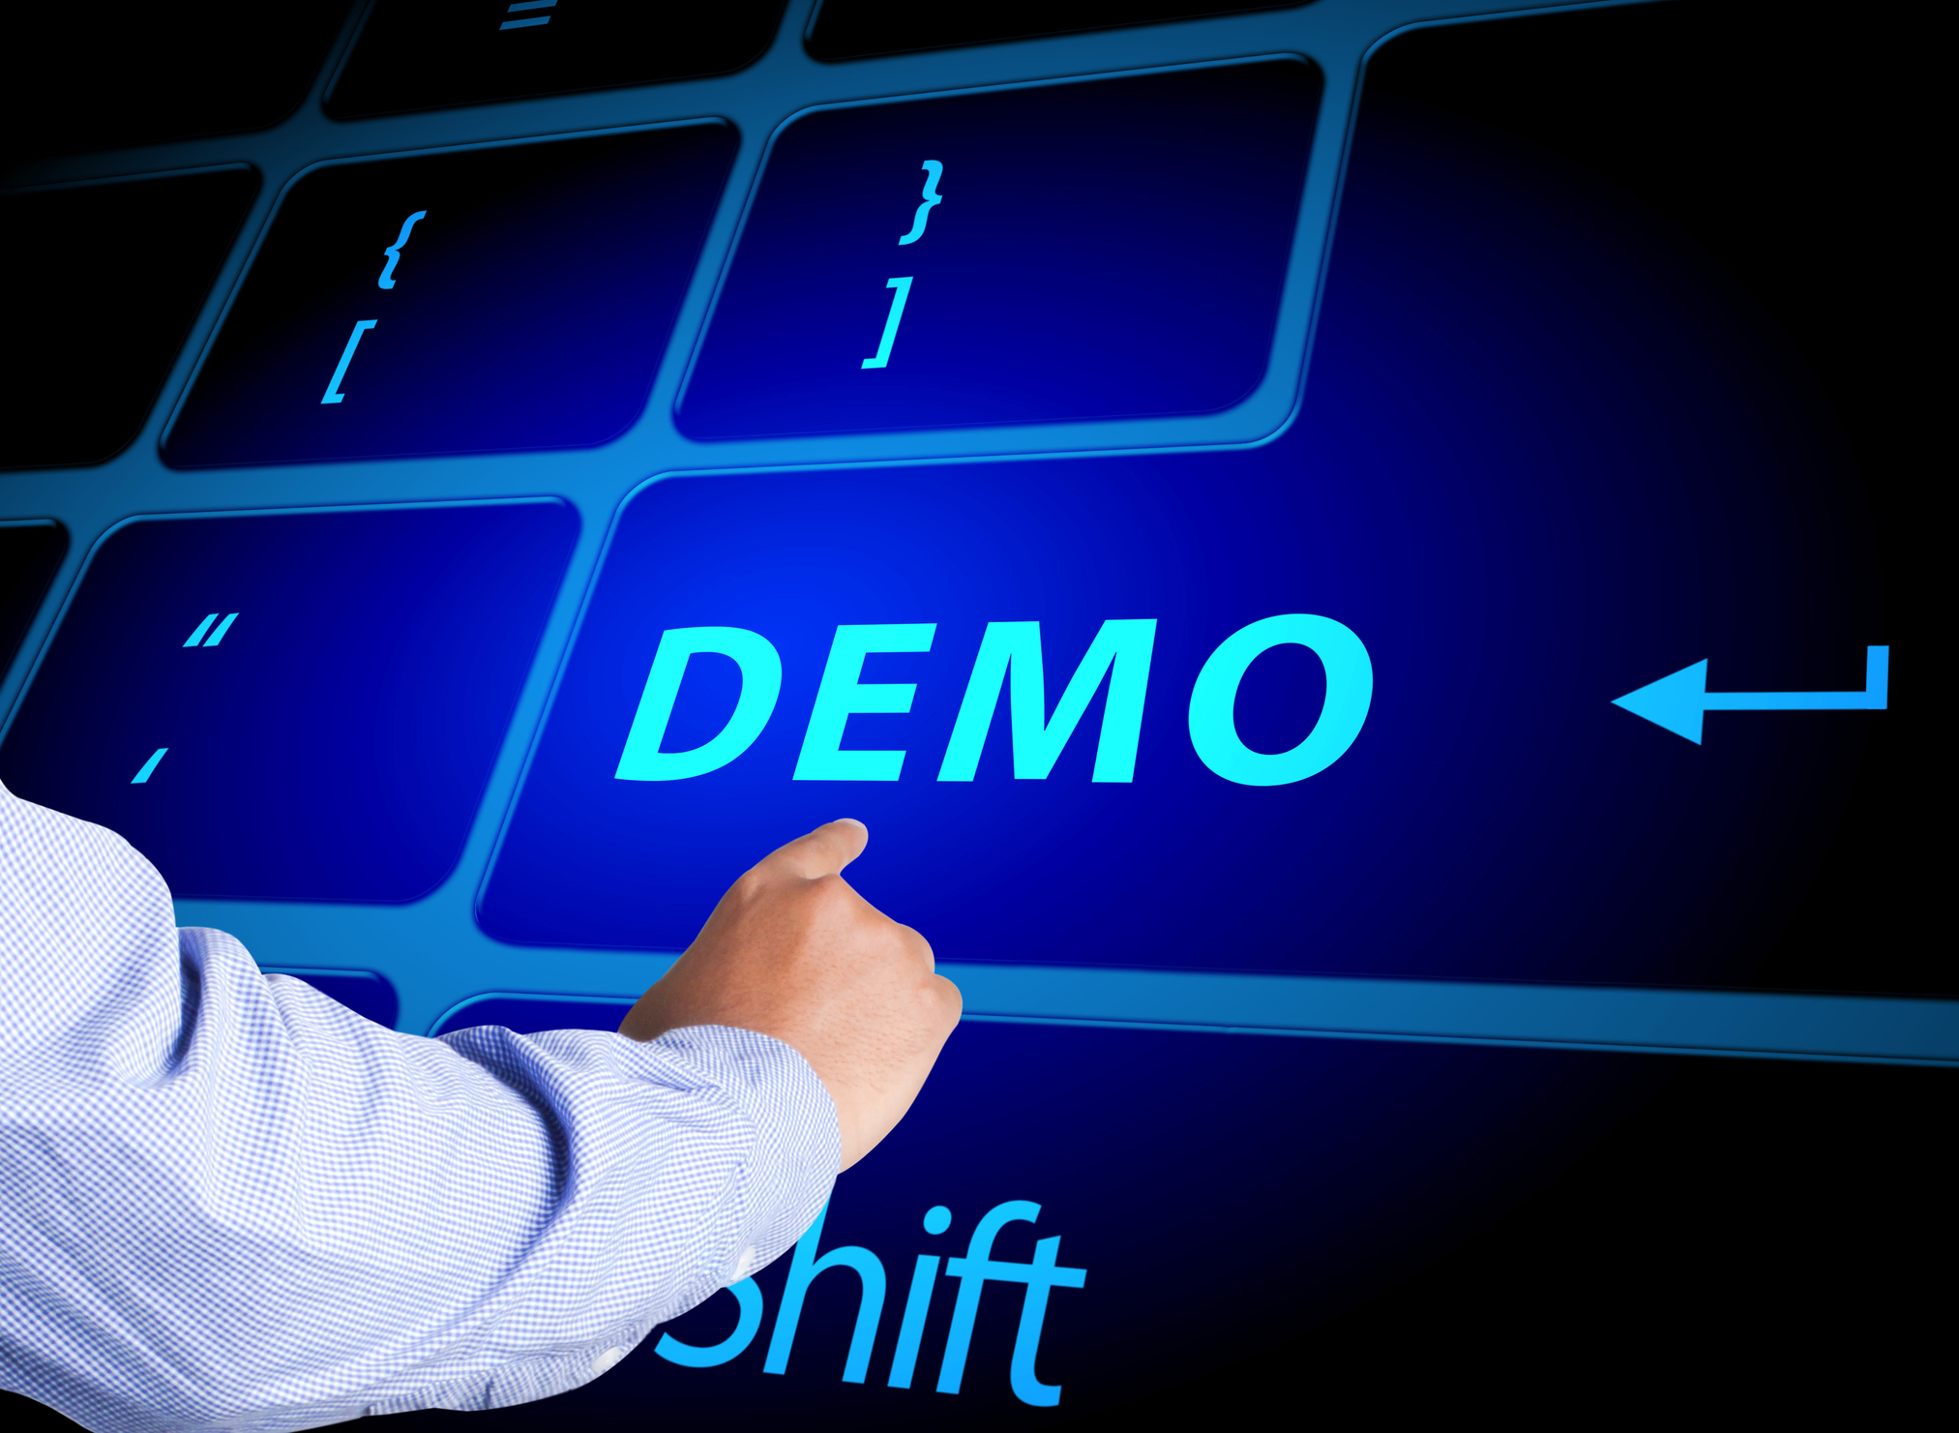

Slide 8
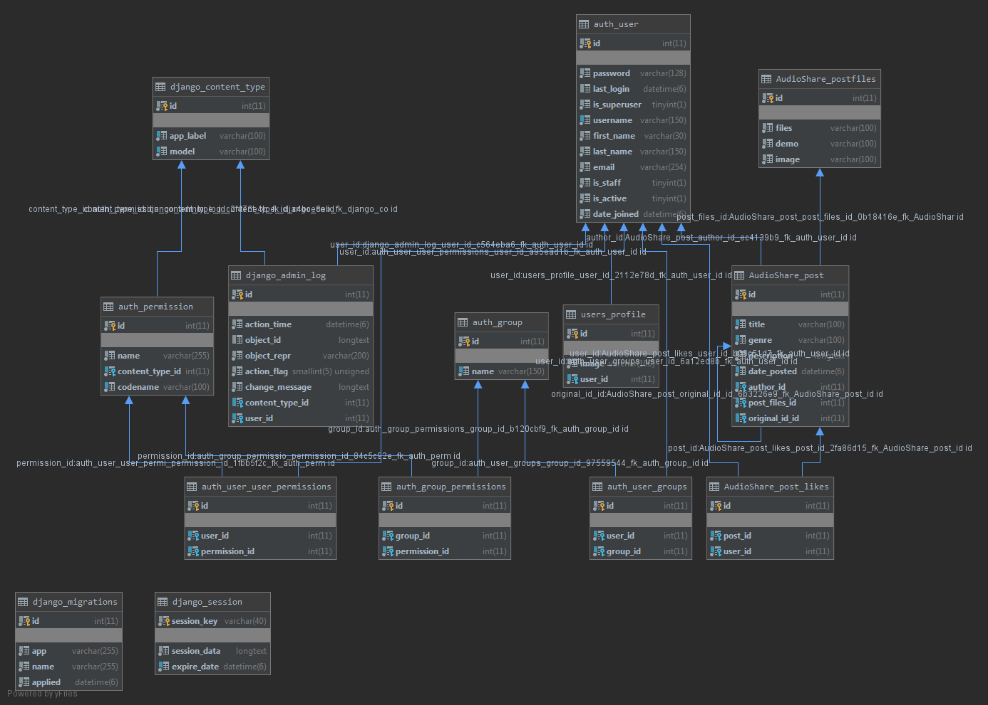
Schema Diagram

Slide 9
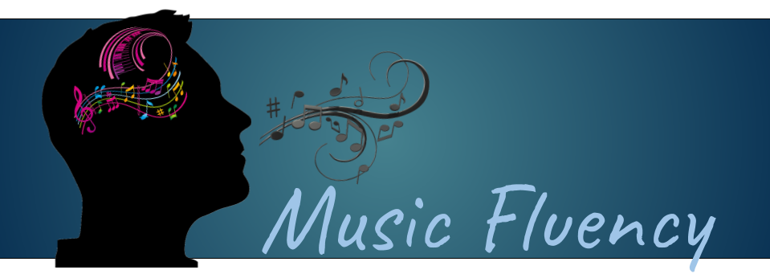
Future Outlook
Music Fluency
Fully deploy to a web server
Implement registration with purchase process
Make some revolutionary music! (and hopefully some money)

